Slide 1
MGS 425 (S1S & S2S) Management of it projects
Week 9 – March 29th

Slide 2
Agenda
Chapter 15 – Multi Level Planning
Chapter 16 – Portfolio Planning
TopHat assignment for this week is due by Sunday, April 4th at end of day.

Slide 3
Multi level planning
Chapter 15

Slide 4
Multi Level Planning
Chapter Outline
Overview
Portfolio Planning
Product Planning (Envisioning)
Vision
High-Level Product Backlog
Product Roadmap
Release Planning
Sprint Planning
Daily Planning
Closing

Slide 5
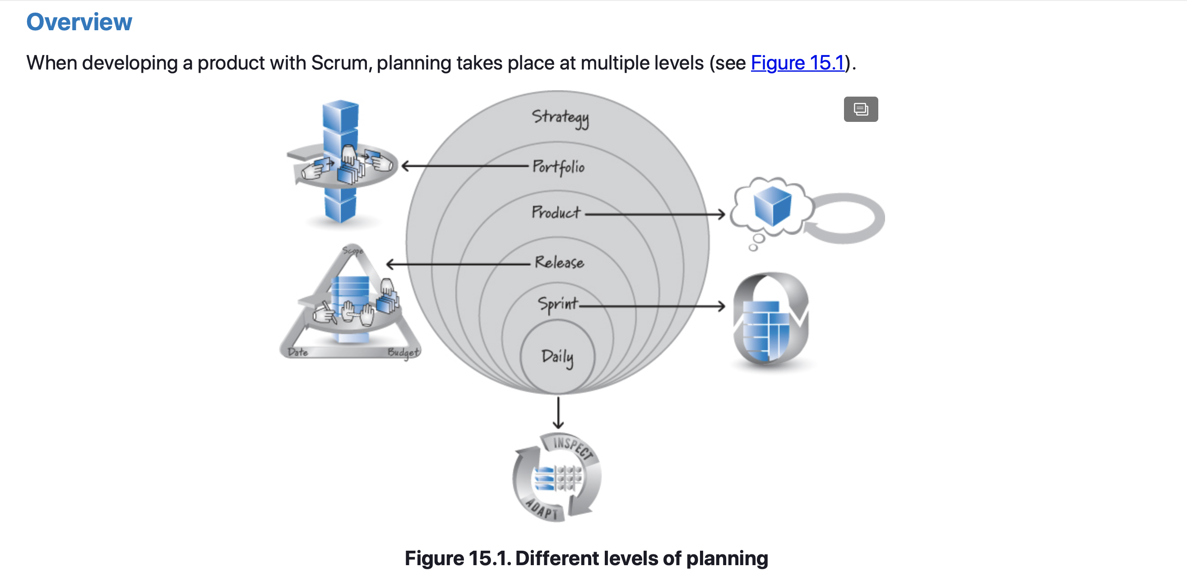
Multi Level Planning – Overview

Slide 6
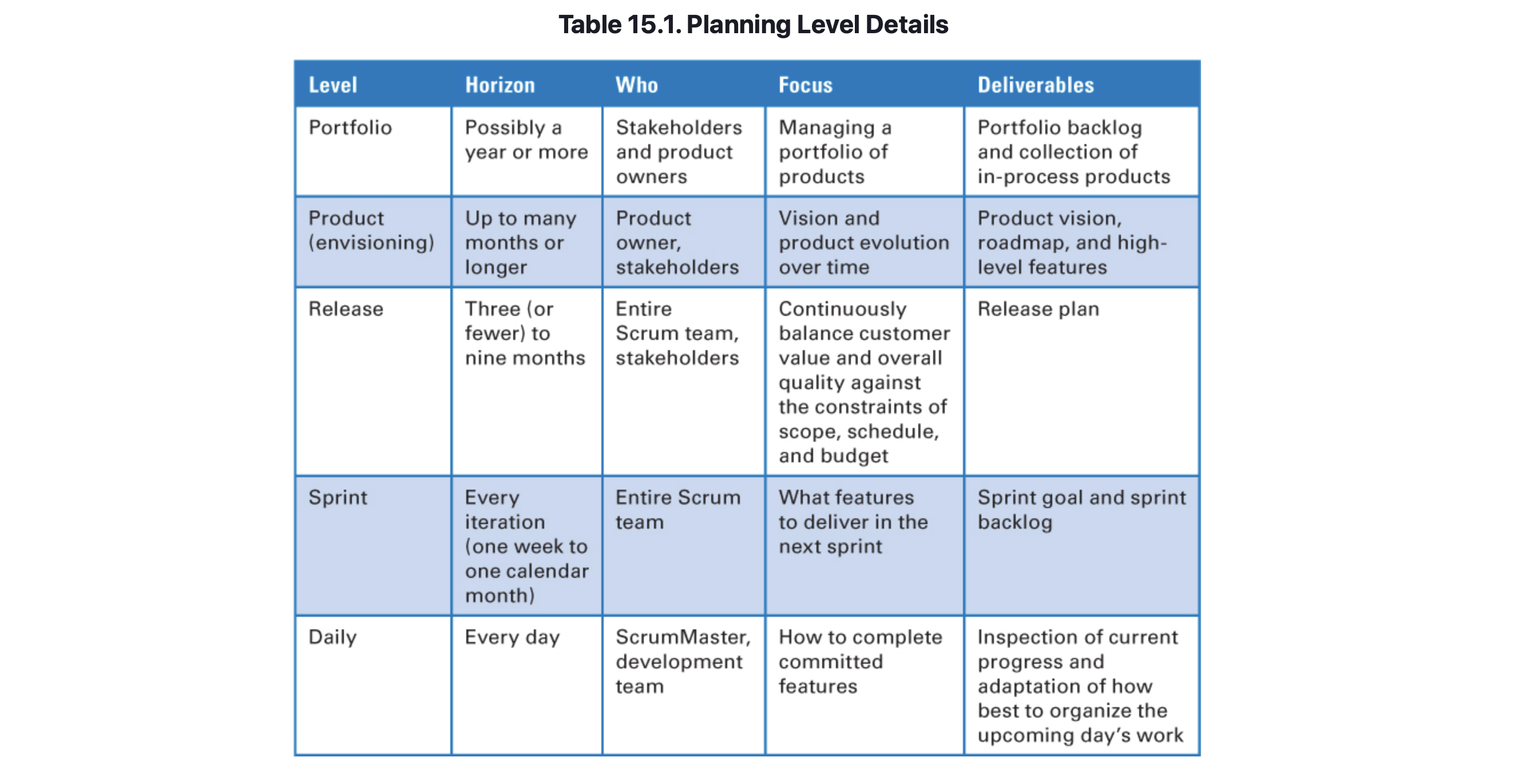
Multi Level Planning – Overview

Slide 7
Multi Level Planning – Portfolio Planning
Portfolio planning (or portfolio management) is an activity for determining which products to work on, in what order, and for how long.
Portfolio planning is conceptually at a higher level than product planning (because it deals with a collection of products), one of its primary inputs could be a newly envisioned product idea from product planning.

Slide 8
Multi Level Planning – Product Planning (Envisioning)
The goals of product-level planning (also referred to as envisioning) are to capture the essence of a potential product and to create a rough plan for the creation of that product.
Envisioning begins with the creation of a vision, followed by the creation of a high-level product backlog and frequently a product roadmap.
Vision
The product vision provides a clear description of the areas in which the stakeholders, such as users and customers, get value.

Slide 9
Multi Level Planning – Product Planning (Envisioning)
High-Level Product Backlog
Once a product vision has been established, the next step is to generate an initial high-level version of the product backlog.
These would typically be “epic-level” user stories.
Product Roadmap
Once a product vision and high-level product backlog have been established, it is helpful to build a product roadmap (sometimes referred to as a release roadmap).
A product roadmap communicates the incremental nature of how the product will be built and delivered over time, along with the important factors that drive each individual release.
Notes:
Today many organizations are striving for continuous deployment, where they deploy working features into production as soon as they become available. If your organization is focused on this practice, you might not need to produce a product roadmap. However, even if you do intend to deploy continuously, a product roadmap might be a useful tool for helping your organization think about larger collections of features, constraints that might dictate which features should be done around the same time, and when certain features should be available.

Slide 10
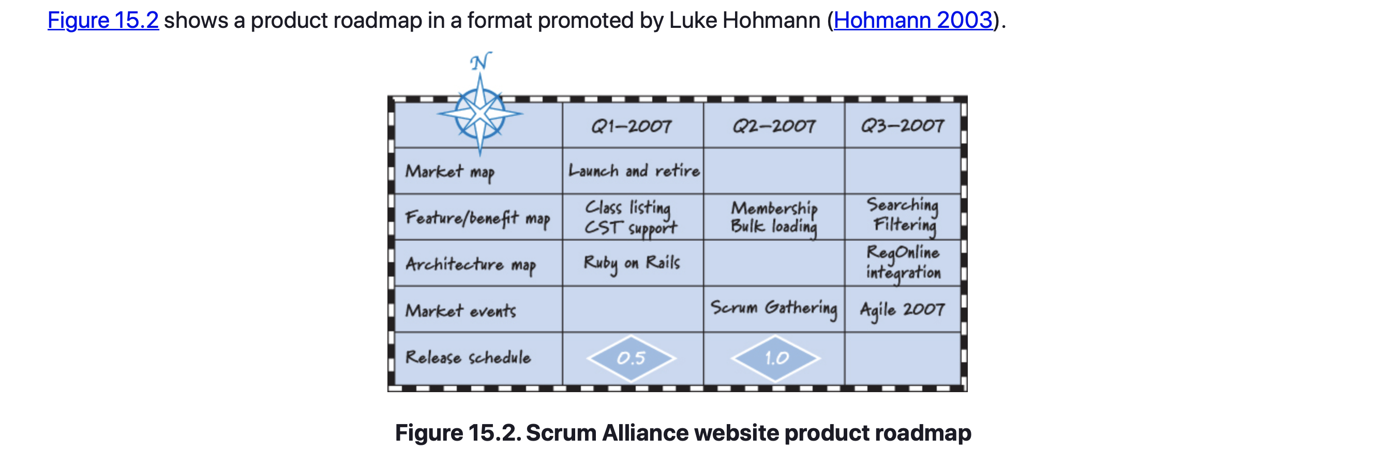
Multi Level Planning – Product Planning (Envisioning)
Notes:
Today many organizations are striving for continuous deployment, where they deploy working features into production as soon as they become available. If your organization is focused on this practice, you might not need to produce a product roadmap. However, even if you do intend to deploy continuously, a product roadmap might be a useful tool for helping your organization think about larger collections of features, constraints that might dictate which features should be done around the same time, and when certain features should be available.

Slide 11
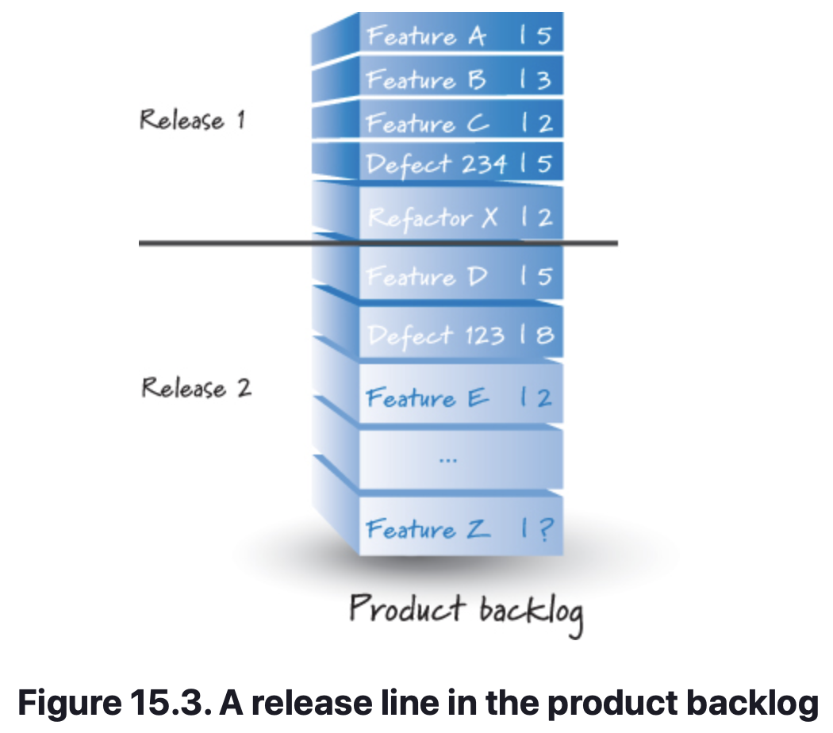
Multi Level Planning – Release Planning
Release planning is about making scope, date, and budget trade-offs for incremental deliveries.
On most development efforts it is sensible and necessary to do initial release planning after envisioning (e.g. product planning) and before starting the first sprint associated with the release.
To have some idea what can be delivered by a fixed date or when you can deliver a fixed set of features, you need to create and estimate a sufficient number of product backlog items.
A simple way to visualize a release is to draw a line through the product backlog (see Figure 15.3). All of the items above the line are planned for the release, and all of the items below the line are not planned for the release.
This line can move up or down in the product backlog as you gain better insight into the product.

Slide 12
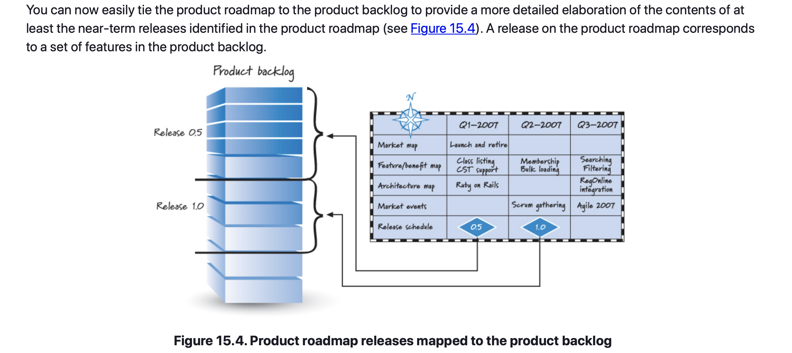
Multi Level Planning – Release Planning

Slide 13
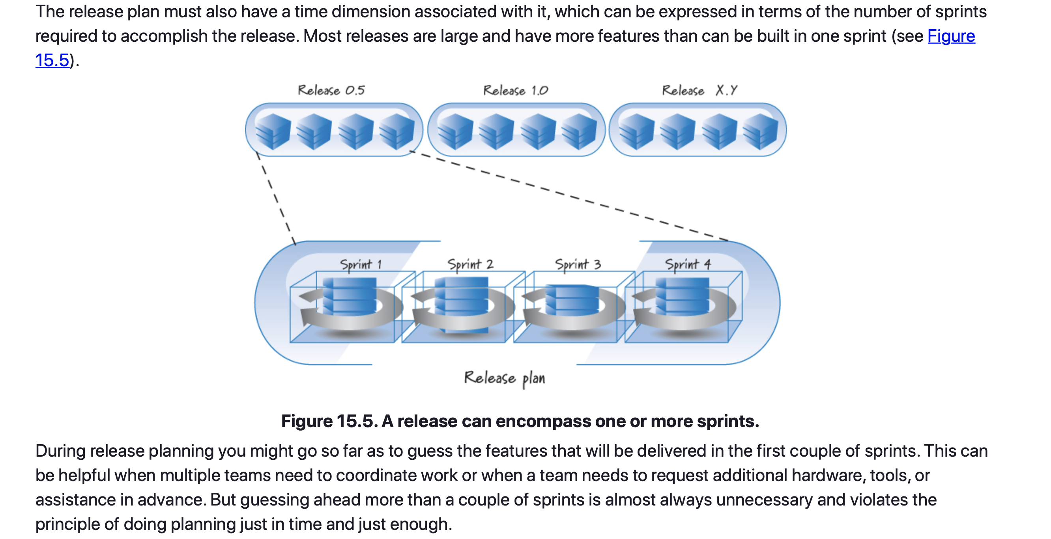
Multi Level Planning – Release Planning

Slide 14
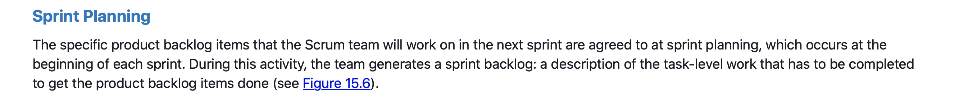
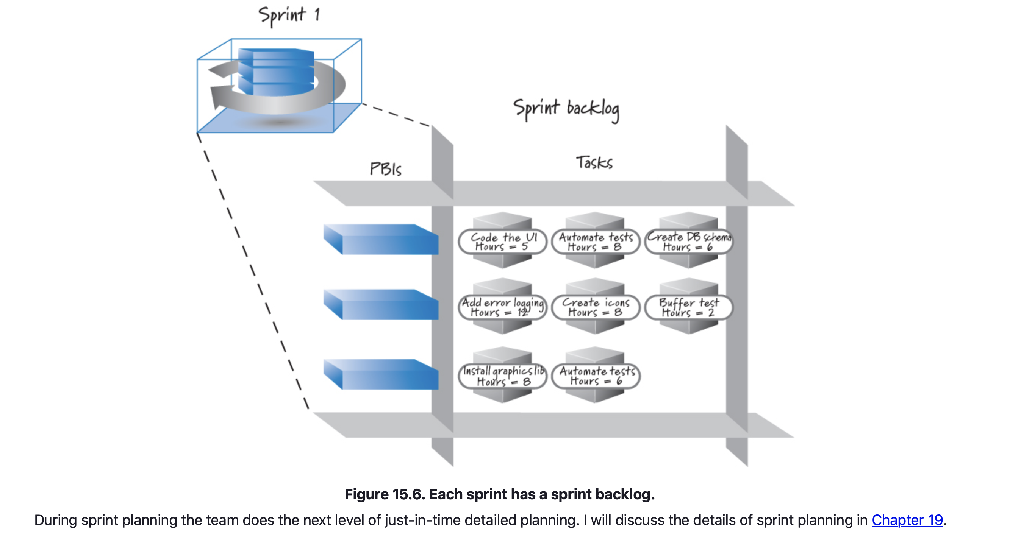
Multi Level Planning – Sprint Planning

Slide 15
Multi Level Planning – Daily Planning
The most detailed level of planning occurs during the team’s daily scrum meeting.
During the daily scrum, team members collectively describe, in a highly visible manner, the big-picture plan for that day.
This also allows the team to use resource alerts. For example, someone might say, “Today I am going to work on the stored procedure task, and I should have that done by lunch. Whoever is going to work on the business logic task, please keep in mind that the business logic task is on the critical path for getting our work done this sprint and you should be ready to work on it right after lunch.”
Such communications can quickly identify potential work blockages and enable a better flow through sprint execution.

Slide 16

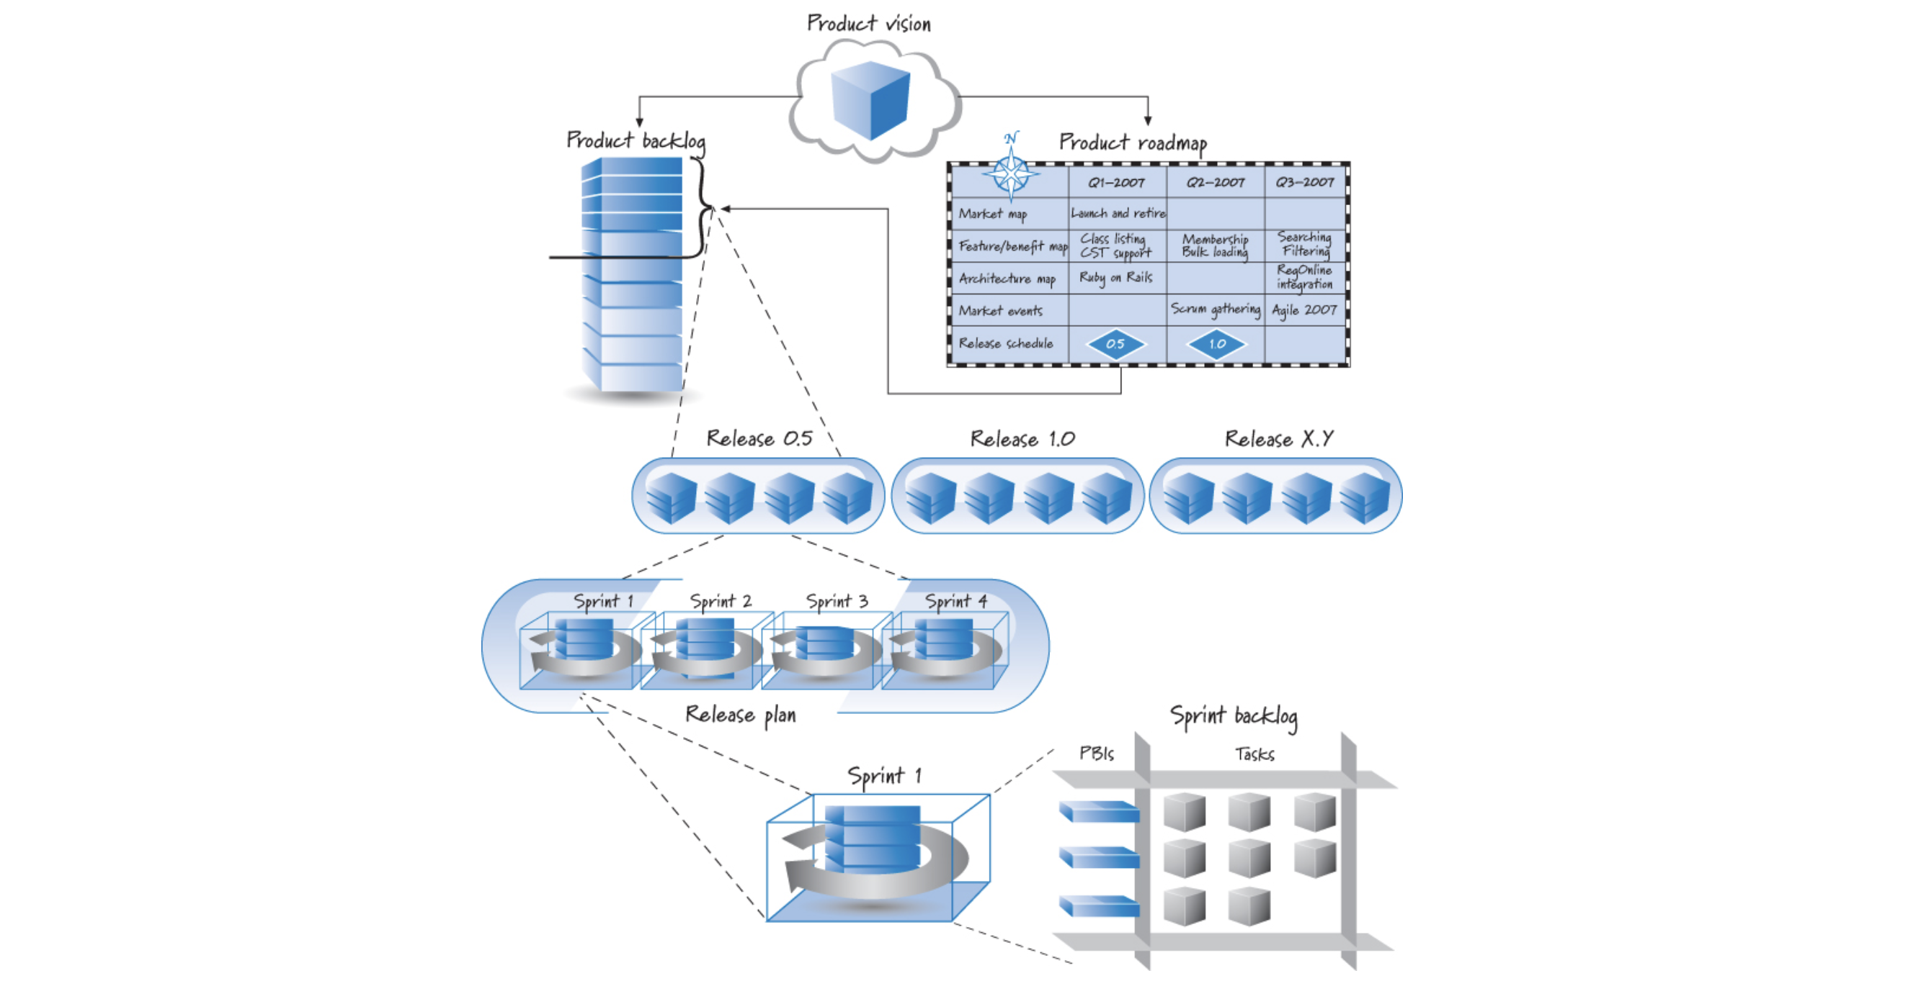
Multi Level Planning – Closing

Slide 17
Portfolio planning
Chapter 16

Slide 18
Portfolio Planning
Chapter Outline
Overview
Timing
Participants
Process
Scheduling Strategies
Optimize for Lifecycle Profits
Calculate Cost of Delay
Estimate for Accuracy, Not Precision
Inflow Strategies
Apply the Economic Filter
Balance the Arrival Rate with the Departure Rate
Quickly Embrace Emergent Opportunities
Plan for Smaller, More Frequent Releases

Slide 19
Portfolio Planning
Chapter Outline
Outflow Strategies
Focus on Idle Work, Not Idle Workers
Establish a WIP Limit
Wait for a Complete Team
In-Process Strategies
Use Marginal Economics
Closing

Slide 20
Portfolio Planning - Introduction
Most organizations want or need to produce more than one product at a time. These multiproduct organizations need a way to make economically sound choices regarding how to manage their product portfolios. They also need their portfolio management or governance processes to align well with core agile practices; otherwise, there will be a fundamental disconnect with the agile approach being used at the individual product level. This chapter lays out 11 strategies for portfolio planning, grouped by scheduling, product inflow, and product outflow. It ends with a discussion of how to determine whether or not more work should be invested in in-process products.

Slide 21
Portfolio Planning – Overview
Portfolio planning (or portfolio management) is an activity for determining which portfolio backlog items to work on, in which order, and for how long.
A portfolio backlog item can be a product, a product increment (one release of a product), or a project (if your organization prefers to plan work around projects).
This chapter refers to the word product generically to mean all types of portfolio backlog items.

Slide 22
Portfolio Planning - Overview
Timing
Portfolio planning is a never-ending activity. As long as there are products to develop or maintain, there will be a portfolio to manage.
Portfolio planning deals with a collection of products and is therefore larger in scope and higher level than individual product-level planning (envisioning).
The output of planning or envisioning a new product is an important input to portfolio planning.
Using data from envisioning, portfolio planning determines whether to fund the product and how to sequence it into the portfolio backlog.
Portfolio planning isn’t just for newly envisioned products, though. It also occurs at regularly scheduled intervals to review products that are already in process (under development, already live in production, or currently being sold).

Slide 23
Portfolio Planning - Overview
Participants
Because portfolio planning focuses on both new products and in-process products, its participants include an appropriate set of internal stakeholders.
The stakeholders must have a sufficiently broad business perspective to properly prioritize the portfolio backlog and make decisions regarding in-process products.
In some organizations the stakeholders collectively form an approval committee, governance board, or some equivalent entity that oversees the portfolio-planning process.
Product owners also participate in portfolio planning as champions of their respective products and advocates for necessary resources.
Frequently the input of senior architects or technical leads is needed to ensure that important technical constraints are factored into portfolio-planning decisions.

Slide 24
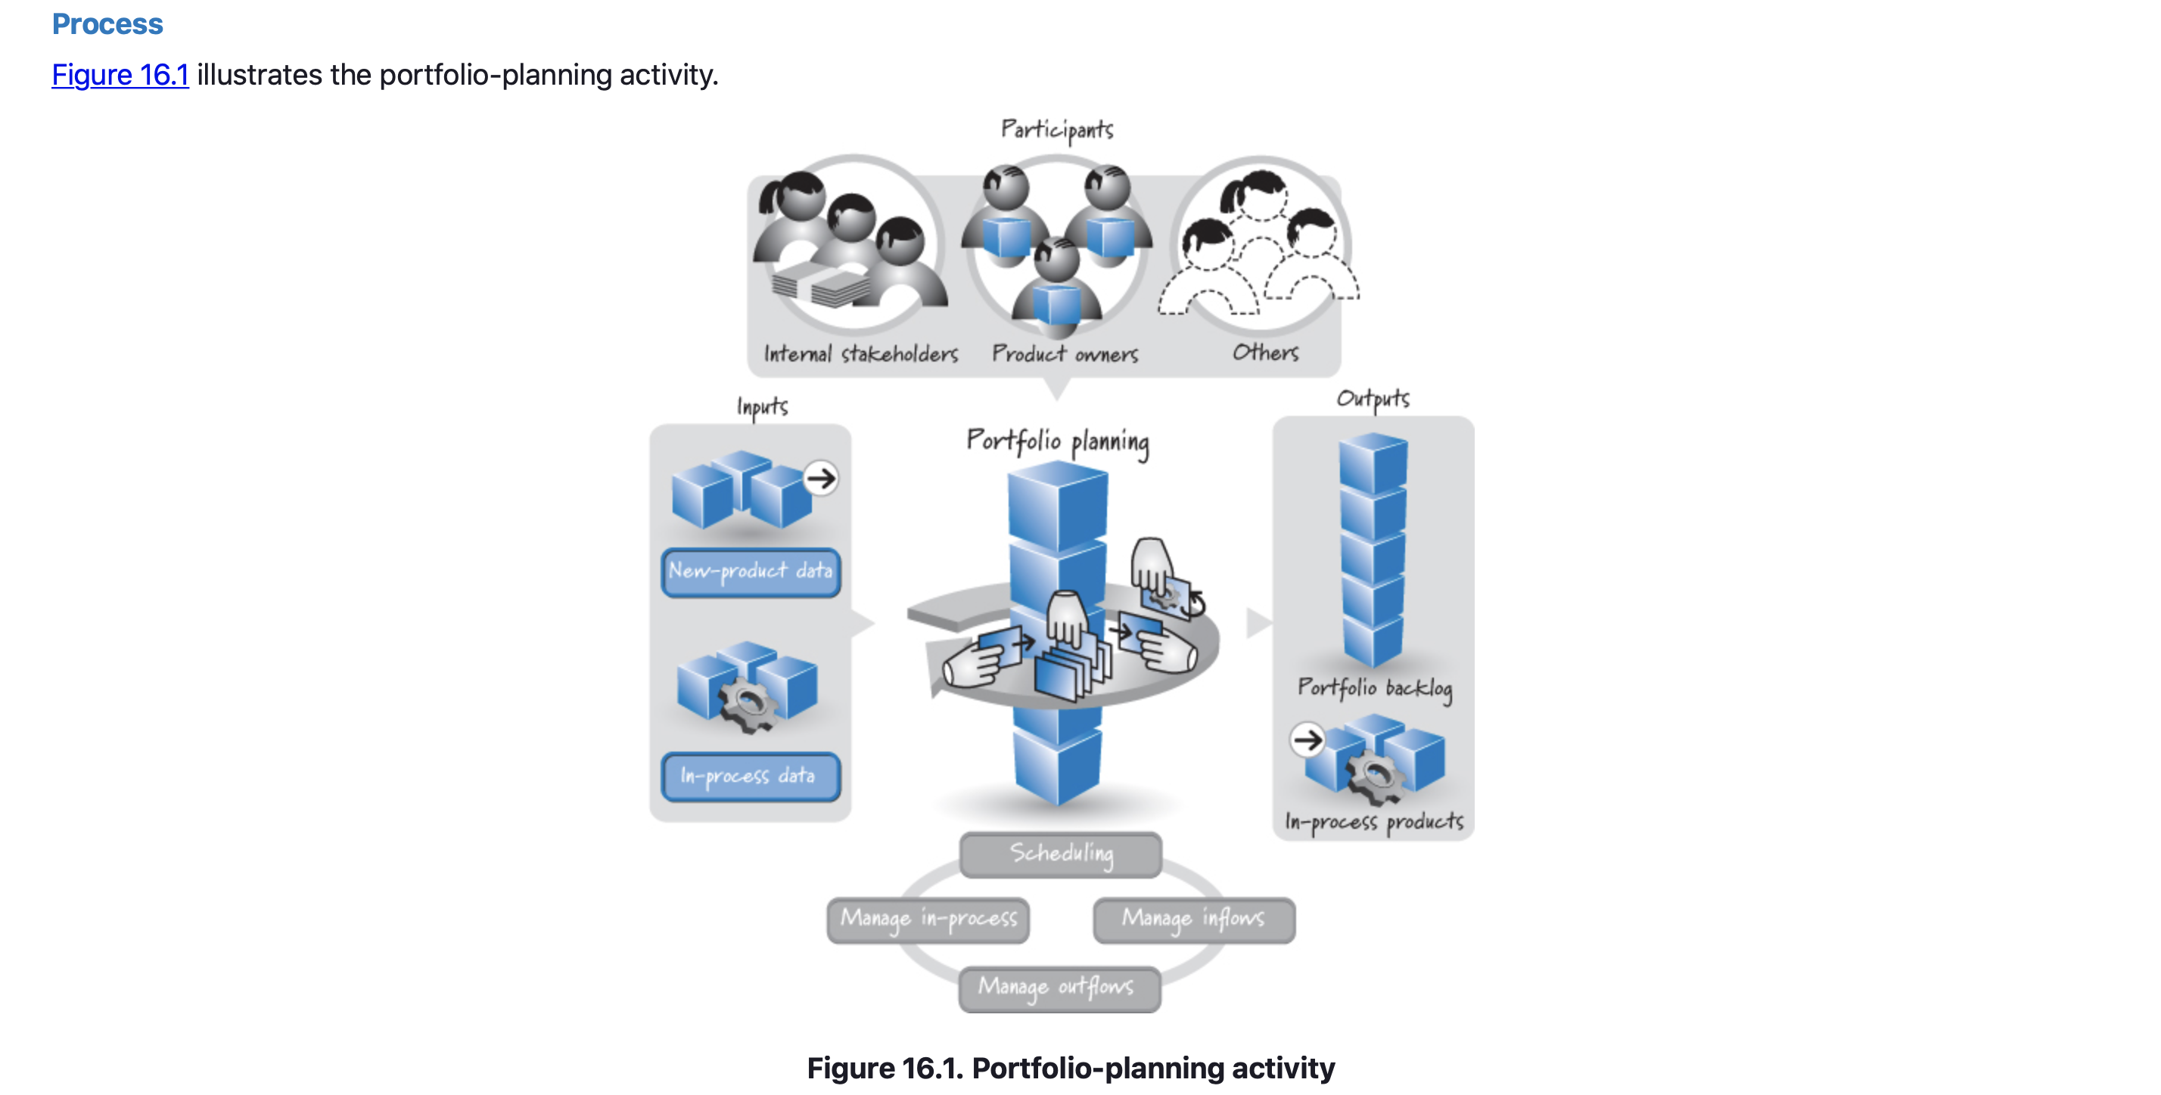
Portfolio Planning - Overview
Process
Notes:
As stated earlier, inputs to portfolio planning include newly envisioned products (candidates for inclusion in the portfolio backlog) and in-process products. The new products come with data that was gathered during envisioning, such as cost, duration, value, risk, and so on. In-process products come with their own set of data, such as intermediate customer feedback, updated cost, schedule, and scope estimates, technical debt levels, and market-related data, which will help determine the path forward for these products.

Slide 25
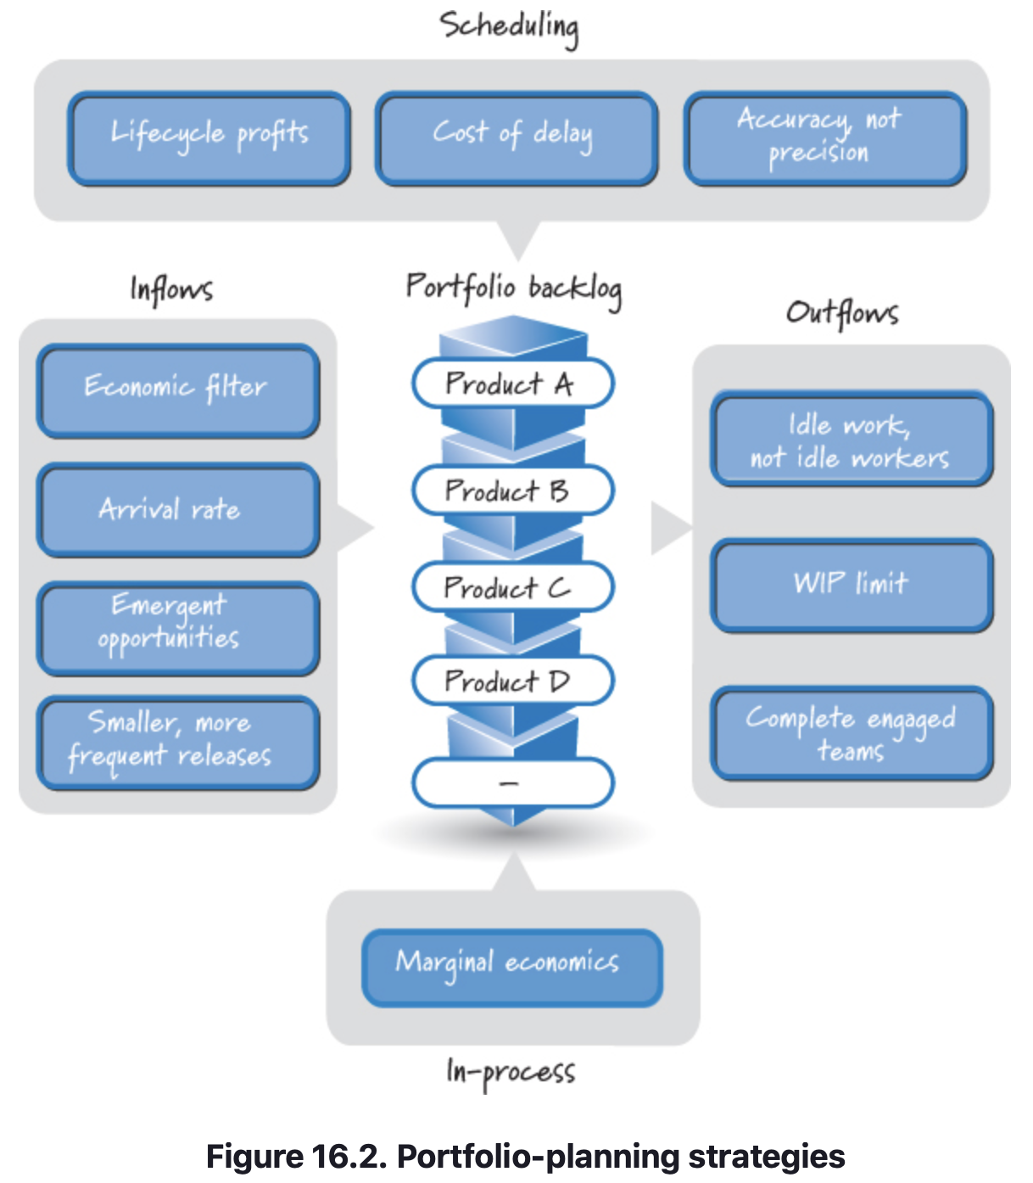
Portfolio Planning - Overview
Process
Portfolio planning has two outputs.
The first is the portfolio backlog, which is a prioritized list of future products, ones that have been approved but for which development has not yet begun.
The second is a set of active products—new products that have been approved and are slated for immediate development, as well as products that are currently in process and have been approved to continue.
To arrive at these outputs, participants engage in four categories of activities: scheduling, managing inflows, managing outflows, and managing in-process products. Figure 16.2 summarizes the specific strategies associated with each of these categories.
Notes:
The scheduling strategies help determine the proper sequence of the products in the portfolio backlog. Inflow strategies guide participants in knowing when to insert items into the portfolio backlog. Outflow strategies inform participants about when to pull a product out of the portfolio backlog. The in-process-product strategy is used to decide when to preserve, pivot, deliver, or terminate a product that is currently in process.

Slide 26
Portfolio Planning – Scheduling Strategies
Portfolio planning must allocate an organization’s limited amount of resources to products in an economically sensible way. Although there are many ways to decide the sequence of products, I focus on three strategies:
Optimize for lifecycle profits.
Calculate the cost of delay.
Estimate for accuracy, not precision.

Slide 27
Portfolio Planning – Scheduling Strategies
Optimize for lifecycle profits
To optimize product ordering within the portfolio we need to decide which variable to measure so that we can determine whether our optimization efforts are working.
Reinertsen recommends that we use an economic framework where we consider all decisions and trade-offs in a standardized and useful unit of measure: lifecycle profits (Reinertsen 2009b).
Based on this recommendation, our goal should be to sequence the items in the portfolio backlog to maximize overall lifecycle profits.
For a specific product, lifecycle profits are the total profit potential for the product over its lifetime.
In the case of portfolio planning, we are interested in optimizing the lifecycle profits of the entire portfolio rather than a single product.

Slide 28
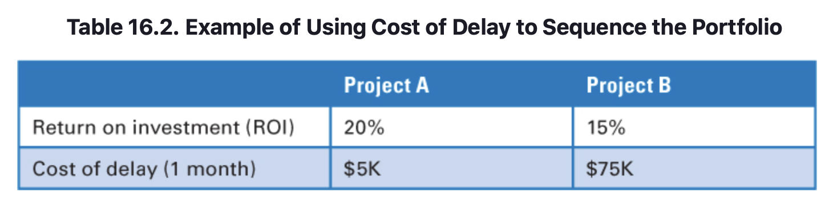
Portfolio Planning – Scheduling Strategies
Calculate the Cost of Delay
When we sequence items in the portfolio backlog, we must necessarily work on some products before we work on others.
Those that we don’t work on immediately have a delayed start and therefore a delayed delivery date, for which there exists a quantifiable cost.
Being blind to the cost of delay, most organizations choose to sequence their portfolio using the simple (and frequently wrong) approach of “high profit first” (see Table 16.2).
Notes:
In this example, project A has a 20% ROI and project B has a 15% ROI. Using the high-profit-first scheduling strategy, we would do project A before project B because it has the higher return on investment. Although this approach seems sensible, it fails to take into account the cost of delay of each product, which could substantially alter the lifecycle profit calculation. For example, what if project A has a $5K/month cost of delay and project B has a $75K/month cost of delay (as shown in Table 16.2)? In this case, delaying project B to work first on project A has a much greater impact on portfolio lifecycle profitability.

Slide 29
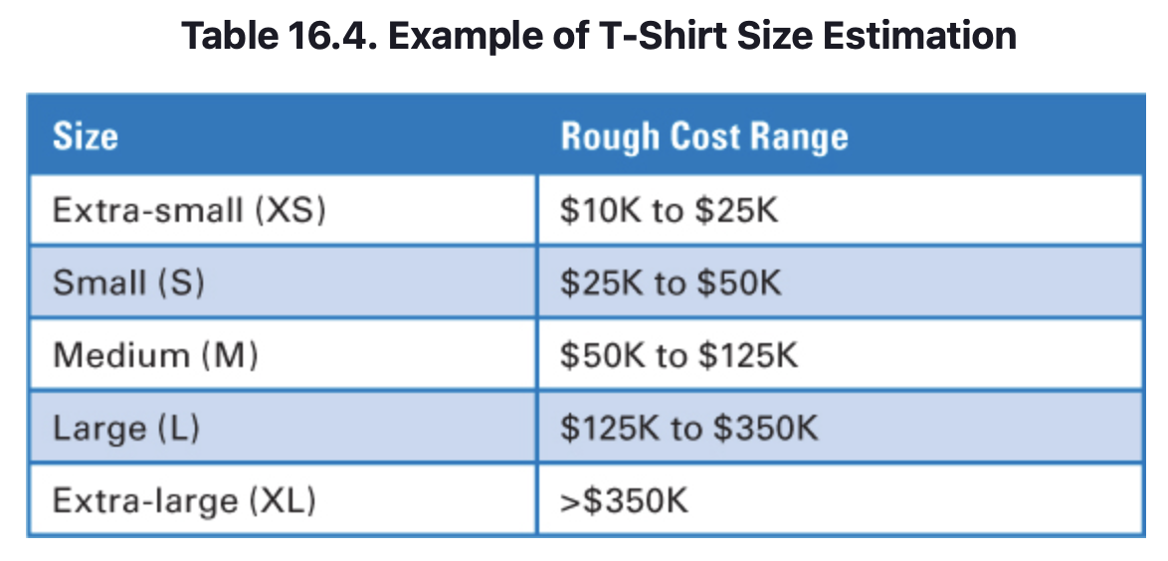
Portfolio Planning – Scheduling Strategies
Estimate for Accuracy, Not Precision
To properly schedule portfolio backlog items we also need to understand their effort/cost (because cost affects lifecycle profits). When estimating the size of portfolio backlog items, we are looking for accuracy, not precision, because of the very limited data we have at the time when a first estimate is required.
Chapter 7 discussed the fact that some organizations prefer to estimate portfolio backlog items using T-shirt sizes instead of overly precise numbers. Each T-shirt size corresponds to an associated cost range (see Table 16.4 for an example of one organization’s mapping).
Notes:
In this example, project A has a 20% ROI and project B has a 15% ROI. Using the high-profit-first scheduling strategy, we would do project A before project B because it has the higher return on investment. Although this approach seems sensible, it fails to take into account the cost of delay of each product, which could substantially alter the lifecycle profit calculation. For example, what if project A has a $5K/month cost of delay and project B has a $75K/month cost of delay (as shown in Table 16.2)? In this case, delaying project B to work first on project A has a much greater impact on portfolio lifecycle profitability.

Slide 30
Portfolio Planning – Inflow Strategies
The envisioning process details the vision for a new product and collects a set of information that the decision makers need in order to make a go/no-go funding decision.
Inflow strategies deal with how to apply the organization’s economic filter to make a go/no-go decision.
They also deal with how to balance the rate at which products are inserted into the portfolio backlog against the rate at which they are being pulled out, how to quickly embrace an emergent opportunity when it appears, and how to prevent portfolio bottlenecks by using smaller, more frequent releases.

Slide 31
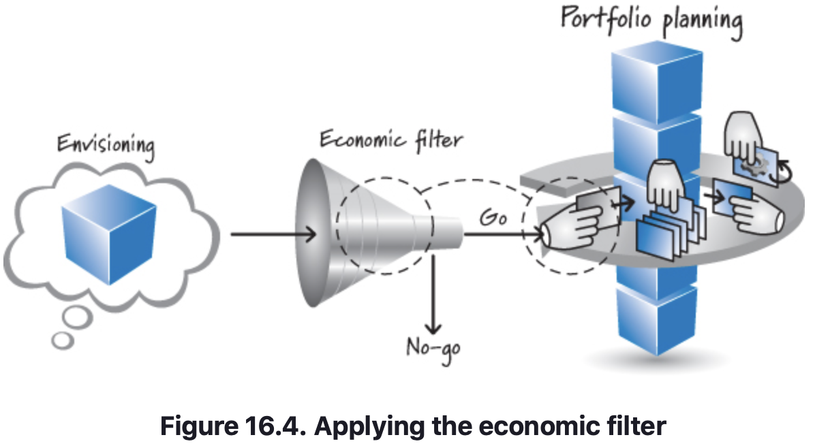
Portfolio Planning – Inflow Strategies
Apply the Economic Filter
The output from envisioning is a product vision along with the information needed to clear the confidence threshold associated with the envisioning (product-planning) activity (see Chapter 17)
This output is the new-product data that is an input to portfolio planning.
Based on this data, the organization needs to make a go/no-go decision for moving forward with development of the product.
We refer to this activity as applying the economic filter to the new product to see if it meets the organization’s funding requirements (see Figure 16.4).
Notes:
Although each organization needs to define an economic filter that best matches its particular funding policies, a good economic filter should quickly indicate approval of any opportunity that delivers overwhelming value relative to its cost; most everything else (unless there are extenuating circumstances) should be rejected. If the resulting value of developing the product completely overwhelms the costs of developing it, it shouldn’t be necessary to spend any significant time discussing it—just approve it and move on to sequencing it into the portfolio backlog. If we find ourselves squabbling over a small difference in cost or value before we can make a decision, we should reject the product because there is clearly not overwhelming economic support for developing it. In most organizations there are simply too many high-value product development opportunities to waste time discussing questionable opportunities.

Slide 32
Portfolio Planning – Inflow Strategies
Balance the Arrival Rate with the Departure Rate
In practice we want a steady stream of products moving into the portfolio backlog balanced against a steady stream of products being pulled from the portfolio backlog.
What we don’t want is to overload the portfolio backlog by inserting too many products into it at the same time. This has the effect of overwhelming the system.
To combat overwhelming the portfolio backlog all at once, we can introduce products to the portfolio at more frequent intervals, for example, monthly (or at least quarterly) instead of annually.
Doing so significantly reduces the effort (and cost) required to review and insert new products into the portfolio and provides more overall stability and predictability to portfolio planning.

Slide 33
Portfolio Planning – Inflow Strategies
Quickly Embrace Emergent Opportunities
Portfolio planning needs to embrace emergent opportunities. An emergent opportunity is one that was previously unknown, or was deemed sufficiently unlikely to occur and therefore not something worth spending money on today.
For example, an the online betting marketplace. Its business is highly regulated by the jurisdictions in which it is permitted to offer its betting exchanges. Regulators around the world are somewhat unpredictable—especially when it comes to gambling—which makes it difficult to know if and when it will ever be possible to offer a product in a particular jurisdiction.
Working in this environment, you need to be prepared for emergent opportunities because regulations can change along with a change in a country’s governing party.
By not acting swiftly, as soon as the opportunity becomes available, the economic value can be lost quickly, hence making it a bad economic choice to pursue it sometime later.

Slide 34
Portfolio Planning – Inflow Strategies
Plan for smaller, more frequent releases
As discussed in Chapter 14, the economics of smaller, more frequent releases are compelling.
We can almost always increase the lifecycle profits of a product if we split a product into a series of smaller, incremental releases.
Large products require a lot of resources for a considerable amount of time. Those resources are now unavailable to many other smaller products that are caught in the queue behind the large product. And, while caught in the queue, each accrues a cost for being delayed.
To combat this issue, some organizations institute a size policy during portfolio planning that specifically limits how large a product development effort may be.

Slide 35
Portfolio Planning – Outflow Strategies
Focus on Idle Work, Not Idle Workers
A key strategy for determining when to pull a product from the portfolio backlog is to remember the principle I discussed in Chapter 3—focus on idle work, not idle workers.
This principle states that idle work is far more wasteful and economically damaging than idle workers. This is contrary to how many organizations manage their portfolio.
This approach will keep everyone very busy. What it will also do is keep the work on every product slow and error-prone. A better strategy is to start working on a product only when we can ensure two things: a good flow of work on the new product and that the new product won’t disrupt the flow on other in-process products.
This strategy is used in close coordination with the next strategy: establish a WIP limit.

Slide 36
Portfolio Planning – Outflow Strategies
Establish a WIP Limit
We should never pull more products out of the portfolio backlog than we have capacity to complete.
Doing so will cause reduced capacity to be available to each product (resulting in each being delayed), as well as cause the quality of work on all products to suffer.
Getting work done slower and at lower quality is not a winning strategy.
So how do we determine the appropriate WIP limit? Knowing how many Scrum teams and knowing what kinds of products they are capable of working on will guide us as to how many and which types of product development efforts we should pursue simultaneously.

Slide 37
Portfolio Planning – Outflow Strategies
Wait for a Complete Team
The final outflow strategy is to wait for a complete Scrum team to be available before starting to work on a product.
Organizations that violate the “Focus on idle work, not idle workers” principle frequently start working on a product when only a couple of people are available.
This is a flawed strategy because it will cause even more work to get blocked on other products, slowing down all product delivery and generating significant delay costs.
Because the unit of capacity in Scrum is the team, we shouldn’t start working on a product if we don’t have a complete Scrum team.
Doing so makes no sense from a Scrum perspective.
An incomplete Scrum team is insufficient for getting features to a done state.

Slide 38
Portfolio Planning – In Process Strategies
Strategies for managing in-process products guide us as to whether it is appropriate to preserve, pivot, deliver, or terminate a product that is currently being worked on. We need to make these decisions at regular intervals (say, the end of each sprint) and occasionally at off-cycle times, when abnormal events occur that require us to revisit our in-process products.

Slide 39
Portfolio Planning – In Process Strategies
Using Marginal Economics
From an economic perspective, all work that has been performed on the product up to the decision point is a “sunk cost.”
We are interested only in the marginal economics of taking the next step.
We should ask ourselves only if spending the next chunk of money is justified by the return that investment would generate.
The hard part is making that decision without burdening ourselves with the money we have already spent.

Slide 40

Portfolio Planning – In Process Strategies
Using Marginal Economics
Using marginal economics, we can decide what to do with products that are currently being developed. For each product we scrutinize under the lens of marginal economics, there are four principal options:
Preserve—continue developing the product.
Deliver—stop working on the product and ship it.
Pivot—take what we have learned and change directions.
Terminate—stop working on the product and kill it.

Slide 41
Portfolio Planning – Closing
Discussed eleven important strategies for portfolio planning (portfolio management), which reinforce one another.
Maximum benefit will be derived by doing all of them.
However, if for some reason we are forced to use just one strategy from each category, the focus should be on cost of delay, smaller and more frequent releases, WIP limit, and marginal economics.
The next chapter covers product planning (envisioning).
The output of that process provides us with candidate products to consider during portfolio planning.

Slide 42
Sources
Unless otherwise noted, all material in these slides were used from the textbook for this course:
Rubin, Kenneth S., Essential Scrum: A Practical Guide to the Most
Popular Agile Process, 1st Edition. Addison-Wesley Professional; 1st
edition (August 5, 2012). ISBN-13: 978-0137043293.

